Slide 1
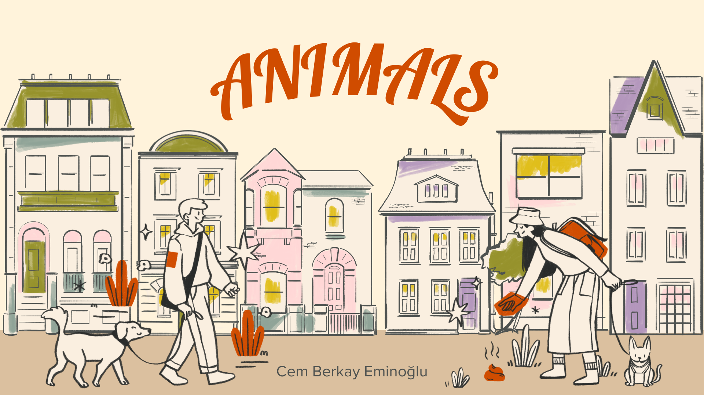

Slide 2
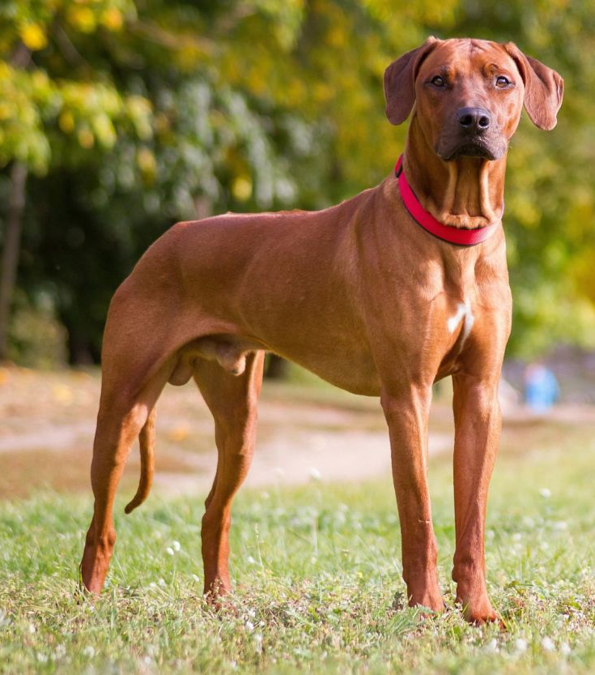
Dogs can bark, run fast, but can’t climb.

Slide 3
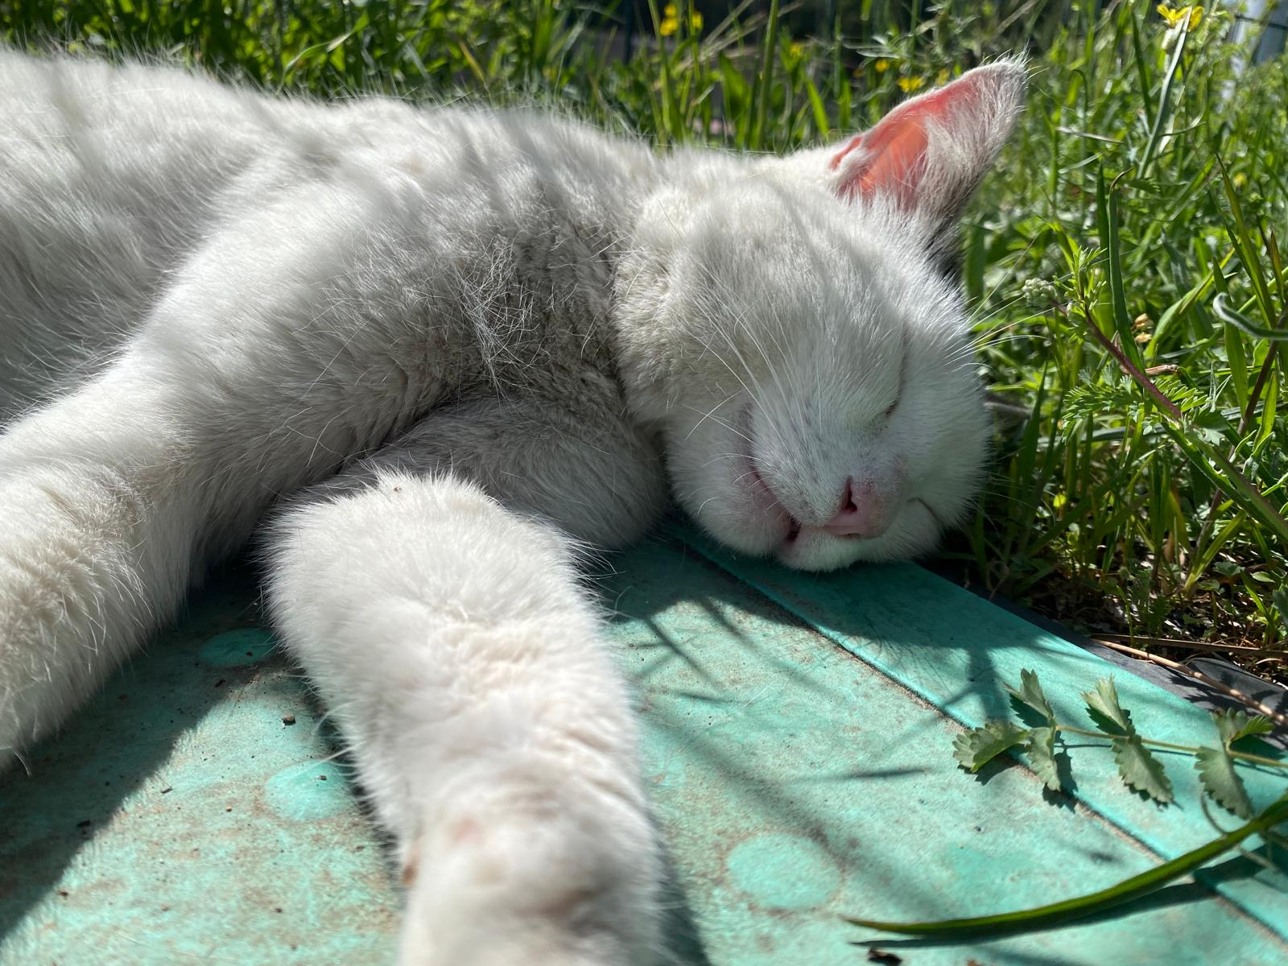
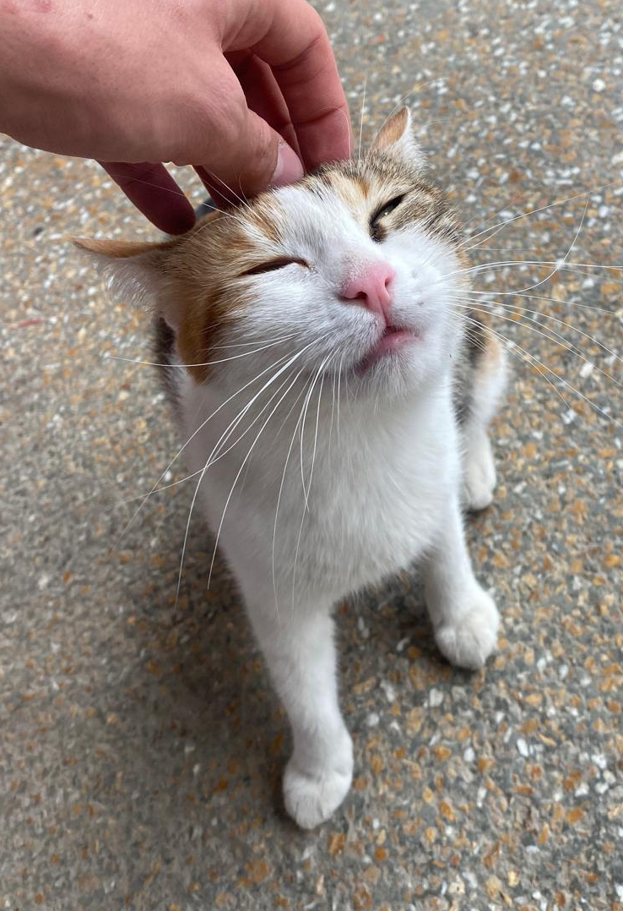
Cats can jump, meow, climb trees, but can’t fly.

Slide 4
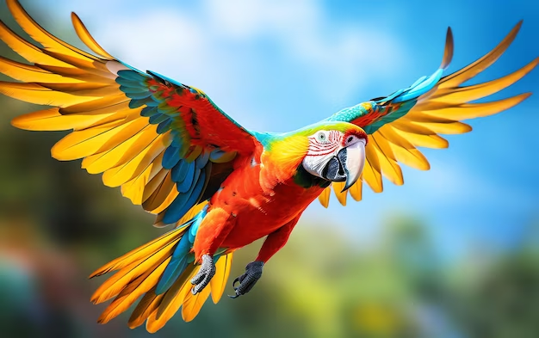
Parrots can fly, but can’t swim or bark.

Slide 5
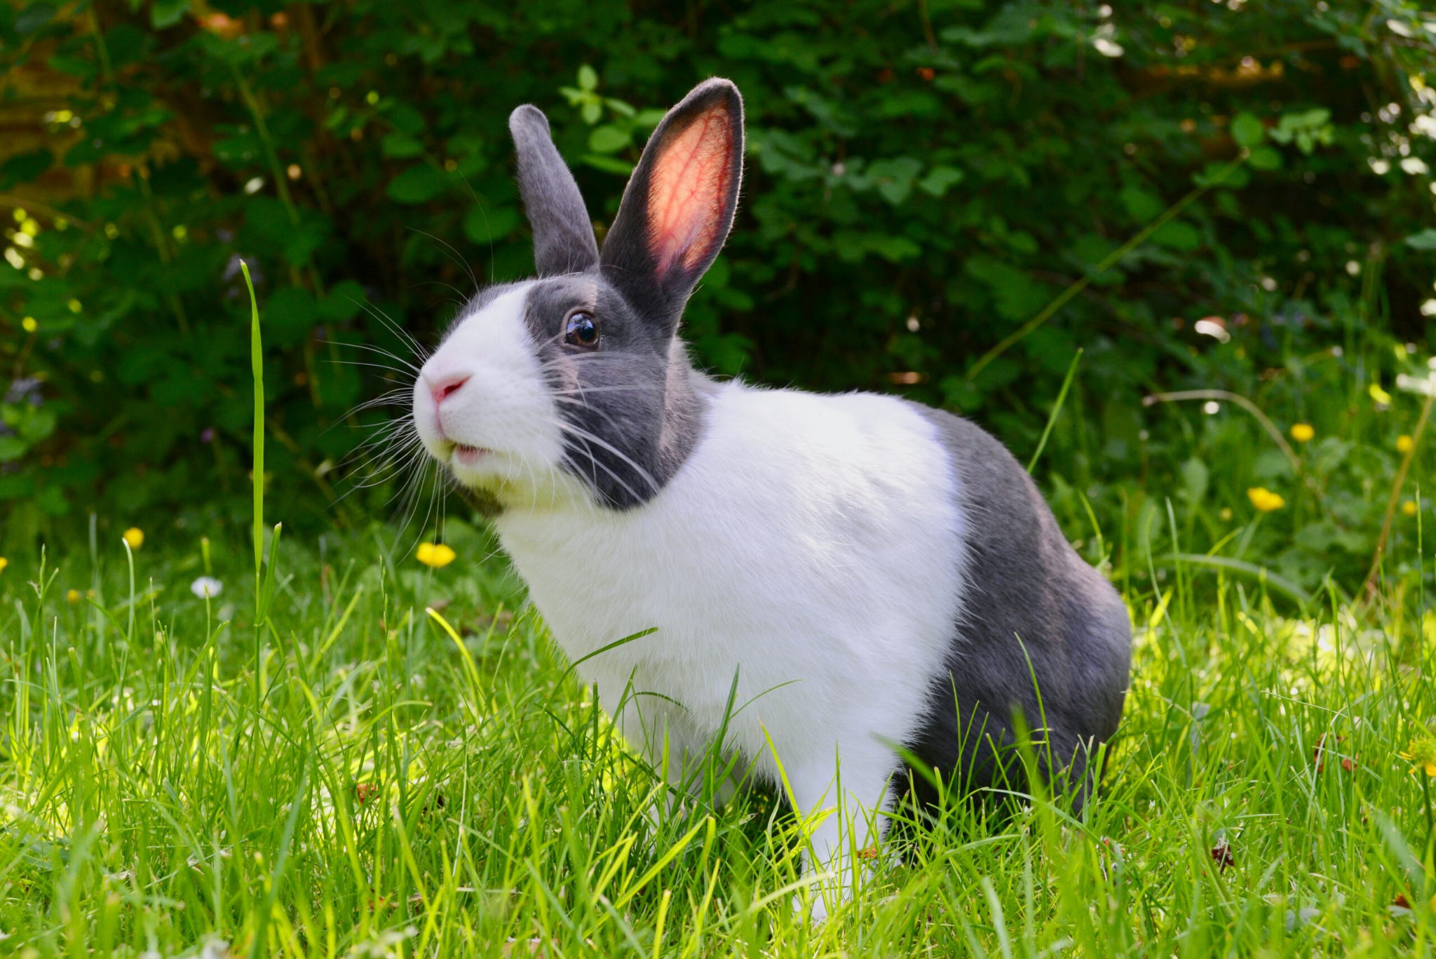
Rabbits can run fast, jump, but can’t meow.

Slide 6
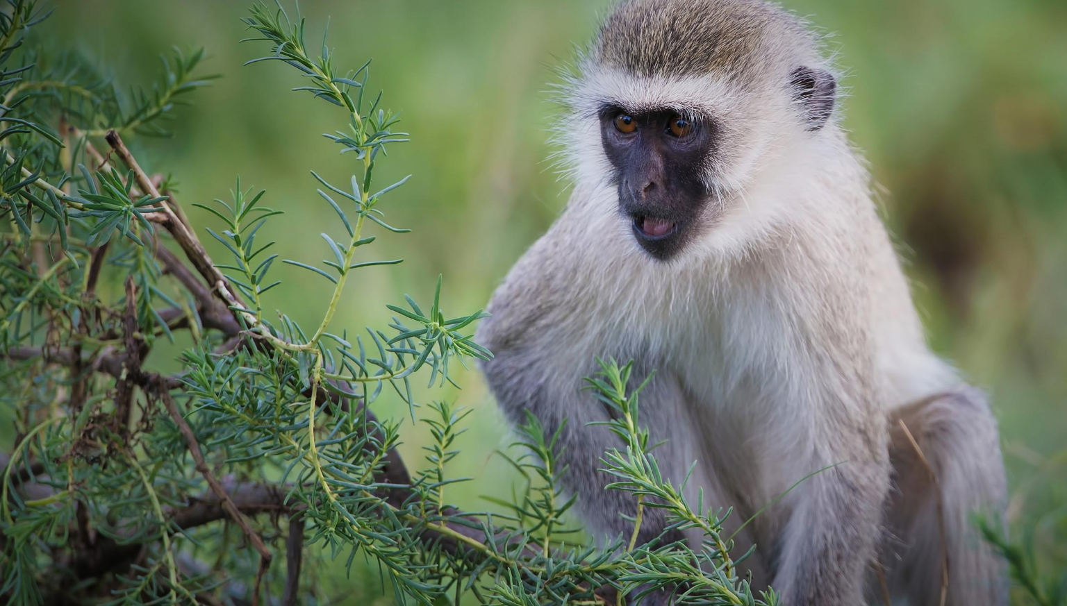
Monkeys can climb trees, run fast, but can’t bark.

Slide 7
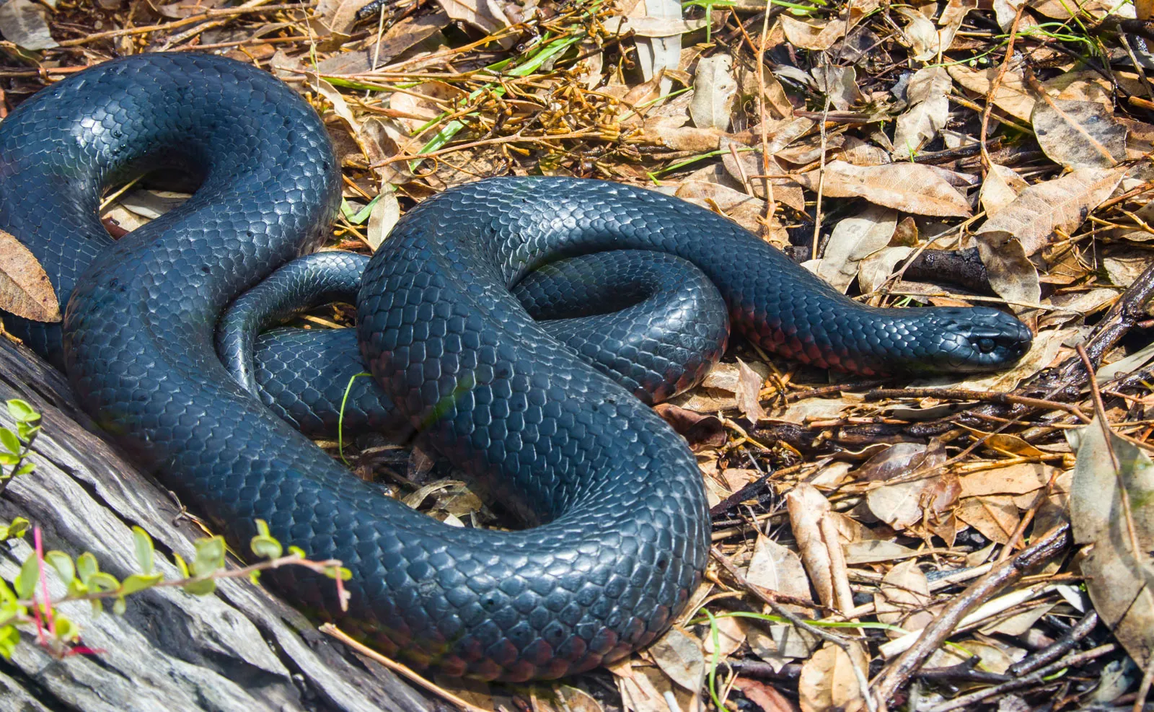
Snakes can crawl, but can’t fly or bark.

Slide 8
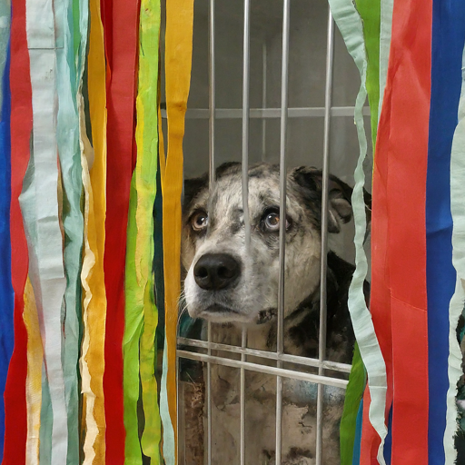
Dogs can run, but Barney can’t, because he is in a cage.

Slide 9
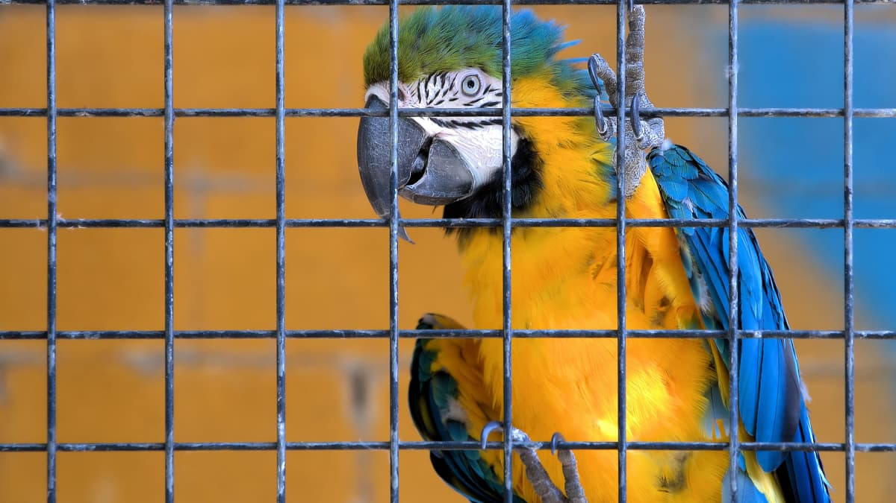
Birds can fly, but this parrot can’t, because it is in a cage

Slide 10
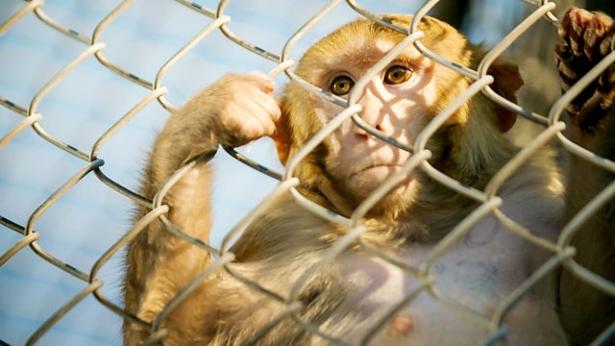
Monkeys can climb trees, but this monkey can’t.

Slide 11
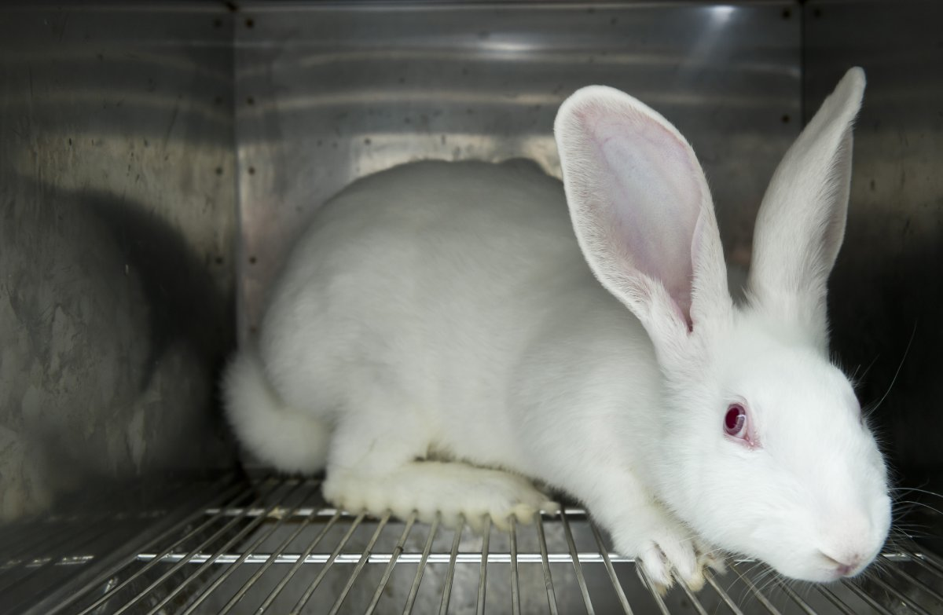
Rabbits can jump and run, but this rabbit can’t.

Slide 12
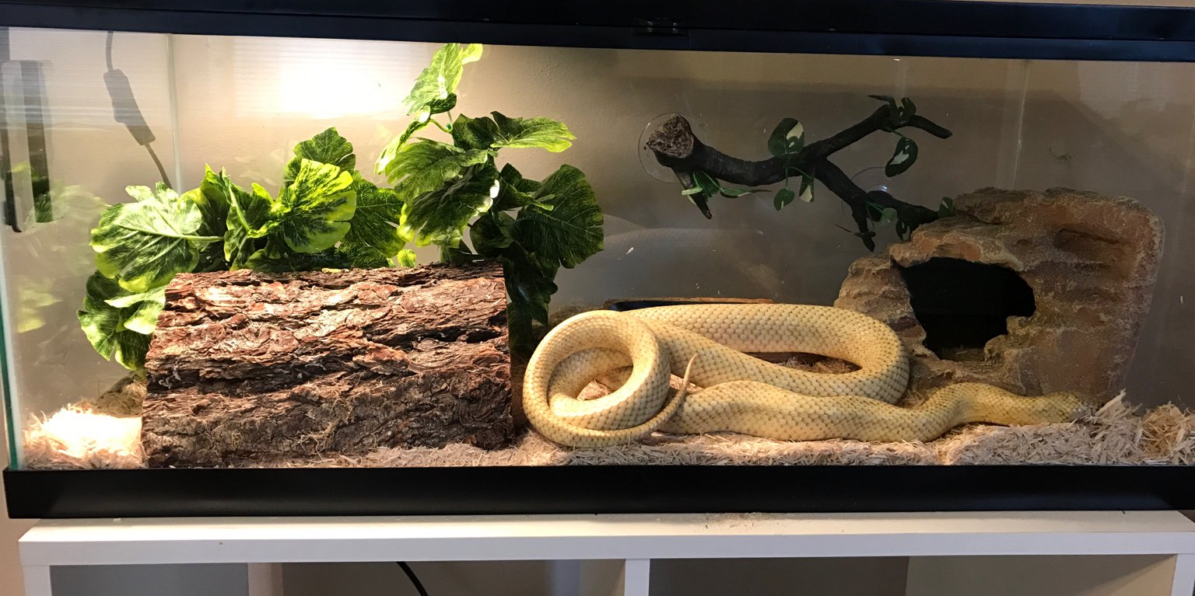
Snakes can swim and climb trees, but this snake can’t

Slide 13

Animals:
Abilities:
bark
run (fast)
climb (trees)
jump
meow
fly
crawl
swim
dog parrot cat
snake rabbit monkey

Slide 14
LET’S PLAY THE GUESSING GAME!

Slide 15
A: Can I run fast?
Class: Yes, you can.
A: Am I a rabbit?
Class: Yes, you are!
A: Can I climb trees?
Class: No, you can’t.
A: Am I a dog?
Class: Yes, you are!

Slide 16
Animals:
Abilities:
bark
run (fast)
climb (trees)
jump
meow
fly
crawl
swim
dog parrot cat
snake rabbit monkey

Slide 17
LET’S WRITE ABOUT FREE ANIMALS!

