Slide 1

EMOTIONAL VIOLENCE
MERVE DURAKLAR

Slide 2
Would you define those cases as violence?
If you do, how would you evaluate their severity?
Do you think that they are acceptable or not?

Slide 3

“I was walking in the rain when I saw an argument between a couple. Although I did not want to involve in their discussion, I could not help myself to stop the man when he punched the women in her face.”

Slide 4
In our classroom, there is a girl named Didi. Since her name is not very common, some students are making fun of her name.

Slide 5
When I talked to Cenk about how he broke my heart when he screamed at me, he said “That never happened.“ I questioned myself all night and doubted from my own memory.

Slide 6
When we were playing volleyball in school, my best friend told me “If we lose points because of you, you will not be my friend anymore.” II felt anxious because I had never played volleyball until that day.

Slide 7
When we were doing group work, Simay said “I am the most successful student in the classroom, so it would be better for you to do what I said in this project”. This affected our collaboration negatively.

Slide 8
What bothers you about those situations?
What are their common points?
What does “emotional violence” mean for you?
Which words do pop up in your mind when you think about “emotional violence”?

Slide 9
Bullying (Didi Example)
Bullying is unwanted, aggressive behavior among school aged children that involves a real or perceived power imbalance.
Verbal bullying: Examples are name calling, making fun of, making jokes at another's expense
Physical bullying: Pushing, shoving, pinching, hitting, spitting
Social bullying: spreading rumours,excluding people from events or study groups.
Cyberbullying: using texting, emails, or other applications to damage someone's reputation.

Slide 10
Gaslighting
Gaslighting happens when an abuser tries to control a victim by twisting their sense of reality.
An example of gaslighting would be a partner doing something abusive and then denying it happened.
“That never happened.“

Slide 11
Emotional Blackmail
Emotional blackmail describes a style of manipulation where someone uses your feelings as a way to control your behavior or persuade you to see things their way.
“If we lose points because of you, you will not be my friend anymore.”

Slide 12
Act Superior
It is acting like master of everything in a group of people or towards an individual and make them feel unsatisfactory.
“I am the most successful student in the classroom, so it would be better for you to do what I said in this project”.

Slide 13
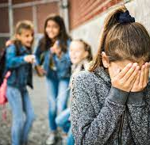
Mine: Hey, let’s play volleyball with Mina.
Pars: I do not think that she will play.
Kiraz: Why?
Mine: Exactly why? Doesn’t she like playing volleyball anymore?
Pars: Of course, she does, but she is sad.
Kiraz: But why?
Mine: She was bullied by her classmates.
Pars: That is so sad. Let’s go to her home to support her.

Slide 14
NEGATIVE QUESTIONS
A negative questions can be formed in English.
Negative: Didn’t you wash the dishes yesterday?
Positive: Did you wash the dishes yesterday?
Negative: Aren’t you going to English class tomorrow?
Positive: Are you going to English class tomorrow?

Slide 15
Negative questions
We use not or n’t to form negative questions. When there is no modal verb or be, we use auxiliary verb do + n’t (don’t, do not, doesn’t, does not, didn’t)
Aren’t you coming? (Verb BE+ Contracted not + subject)
Doesn’t he understand? (Auxiliary verb + Contracted not + subject)

Slide 16
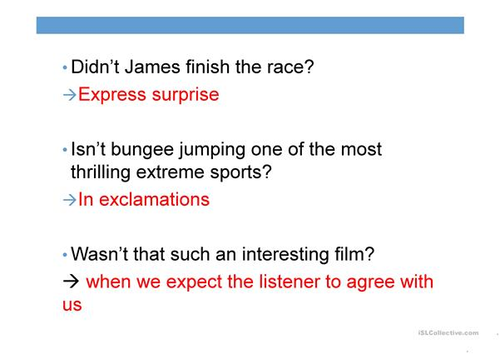

Slide 17
Confirmation
Didn’t you see Ann yesterday? How is she doing? (= I believe that you saw Ann yesterday.)
Express your opinions in polite way
Wouldn’t it be nice to paint that wall green? (More polite than ‘It would be nice to paint that wall green.’)
Surprised
Hasn’t the postman come yet?

Slide 18

A: Dua Lipa dropped a new album called “Future Nostalgia” last night. …………………………………(listen) it last night? I thought you are a big fan.
B: I did not listen because I had a lot of homework to do yesterday.

Slide 19
A: Dua Lipa dropped a new album called “Future Nostalgia” last night. ……Didn’t you listen……………………………(listen) it last night? I thought you are a big fan.
B: I did not because I had a lot of homework to do yesterday.

Slide 20
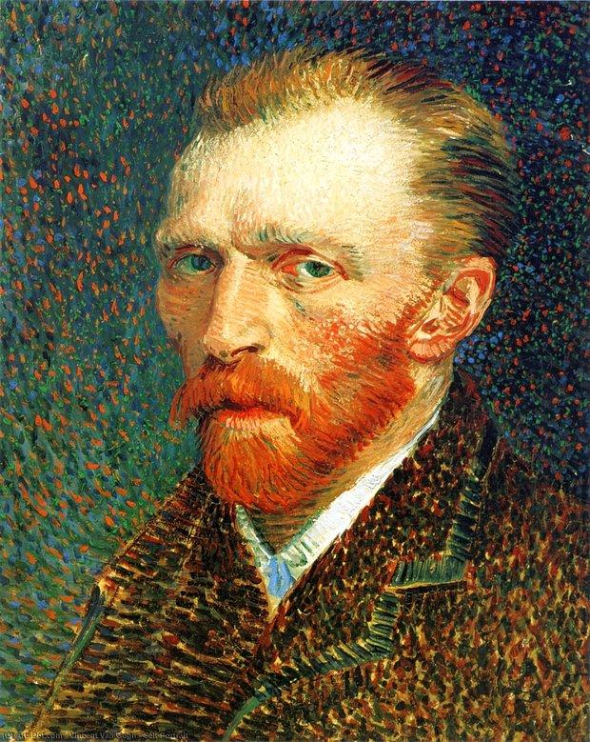
A: I love the paintings of Van Gogh. ………………. the most creative artist in the world?
B: Yes, he is very creative.

Slide 21
A: I love the paintings of Van Gogh. …Isn’t he……………. the most creative artist in the world?
B: Yes, he is very creative.

Slide 22
Aybars: I have a friend whose husband uses emotional blackmail towards her.
Cenk: So sorry to hear that. However, what does her husband exactly do?
Aybars: ……………………. (know) what emotional blackmail is?
Cenk: I know the meaning, but I could not understand how it exactly takes place in real life.
Tuna: Maybe, you can give examples for Cenk to understand.
Aybars: For example, he says “I will not hug you, if you do not do the housework.”
Cenk: Oh, I got it. This sounds terrible.
Tuna: Cenk, …………………….. (think) you need to find ways to support your friend?
Aybars: Of course, I do. That’s why I wanted to talk to you.
Cenk: I think listening to her and being sensitive about her pain might help her.

Slide 23
Aybars: I have a friend whose husband uses emotional blackmail towards her.
Cenk: So sorry to hear that. However, what does her husband exactly do?
Aybars: …Don’t you know…………………. (know) what emotional blackmail is?
Cenk: I know the meaning, but I could not understand how it exactly takes place in real life.
Tuna: Maybe, you can give examples for Cenk to understand.
Aybars: For example, he says “I will not hug you, if you do not do the housework.”
Cenk: Oh, I got it. This sounds terrible.
Tuna: Cenk, …Don’t you think………………….. (think) you need to find ways to support your friend?
Aybars: Of course, I do. That’s why I wanted to talk to you.
Cenk: I think listening to her and being sensitive about her pain might help her.

Slide 24
Sources
www.englishgrammar.org
www.verywellmind.com
www.healthline.com

