Slide 1
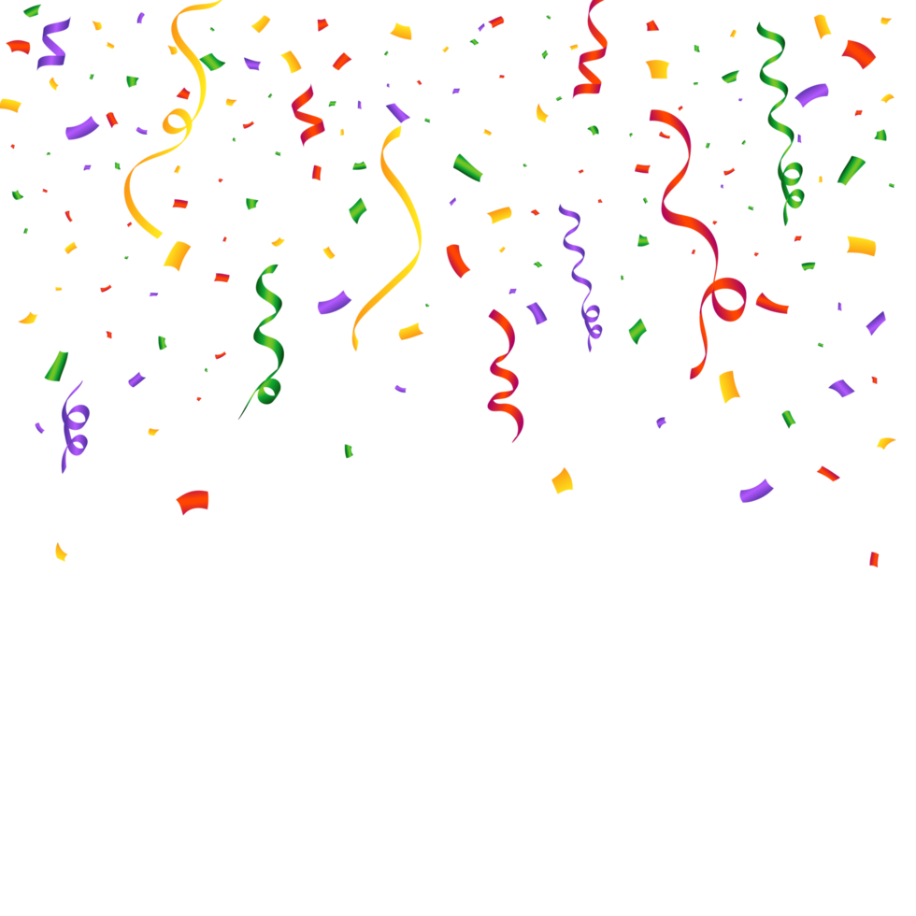
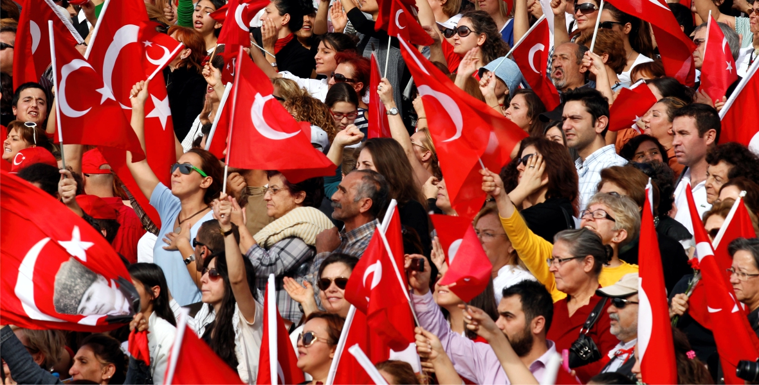
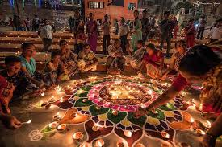
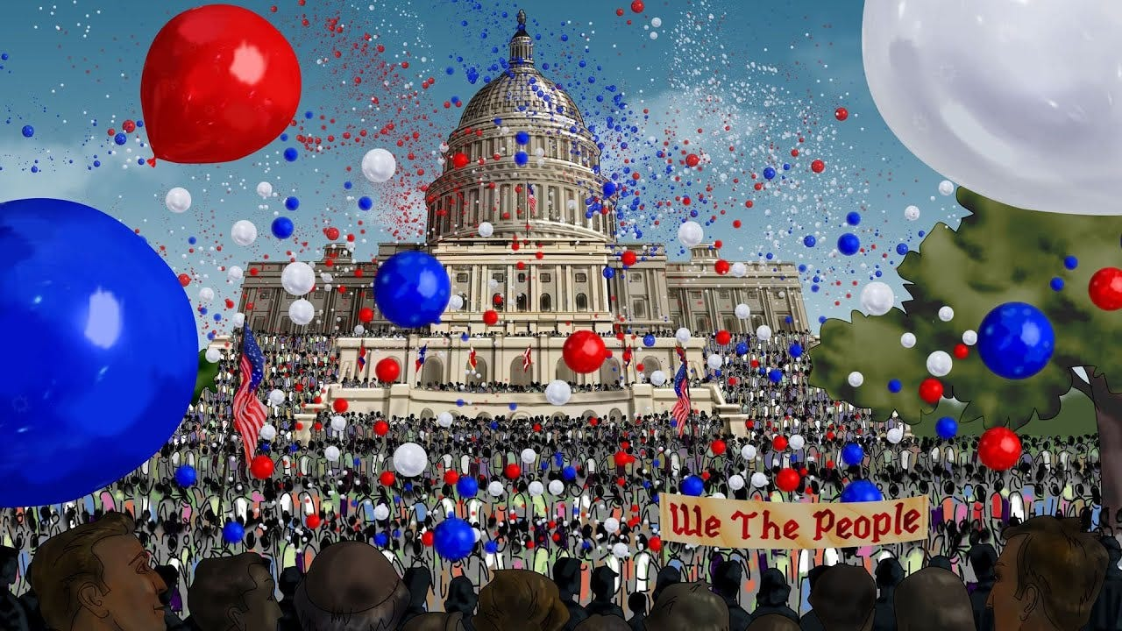
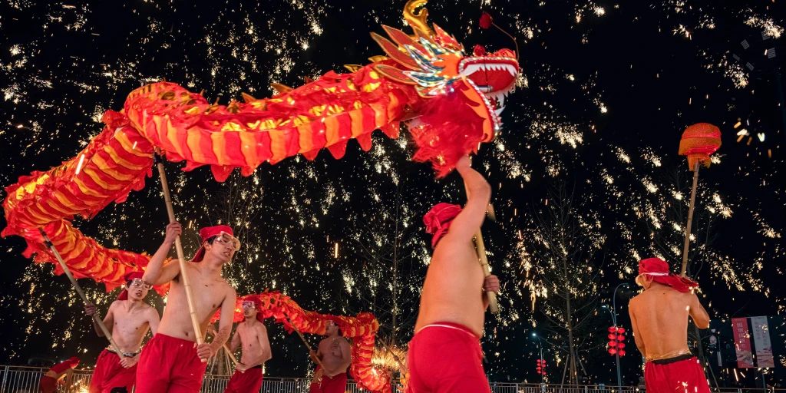
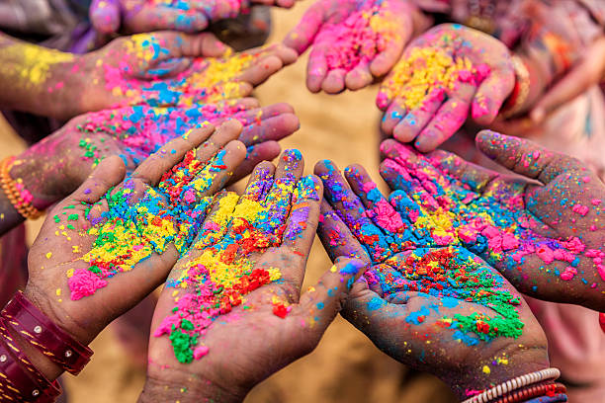

Festivals
by Betül Demirezen

Slide 2
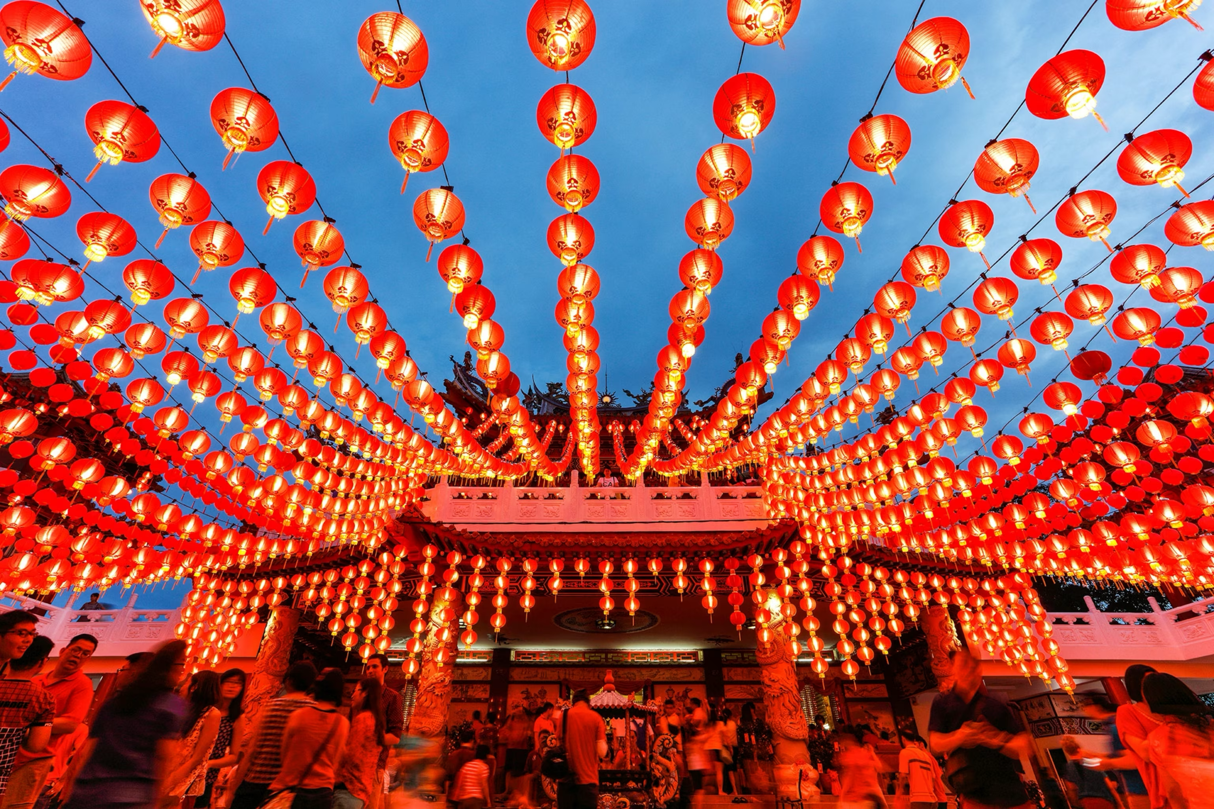
Which festival is this?
CHINEESE NEW YEAR

Slide 3
What do Chinese people celebrate?
-They celebrate New year.
What do Chinese people do for Chinese New year?
They wear red dresses.
They decorate streets with lanterns and firecrackers.

Slide 4
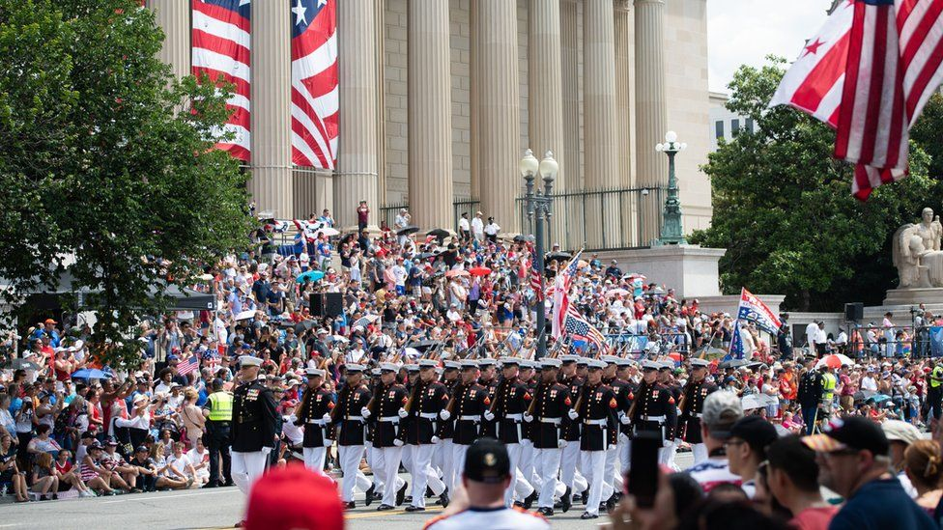
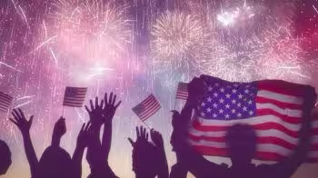
Which festival is this?
INDEPENDENCE DAY

Slide 5
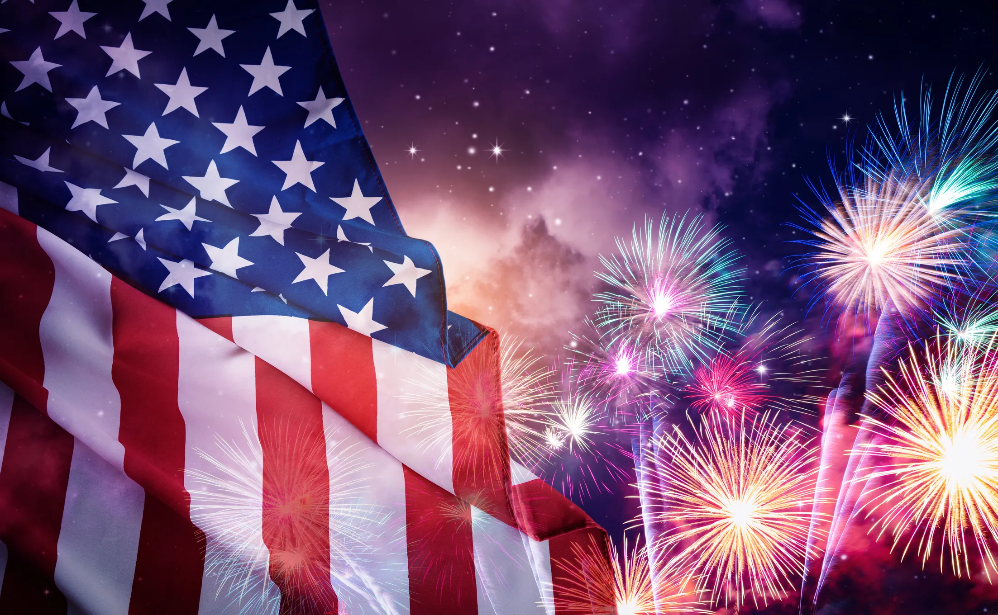
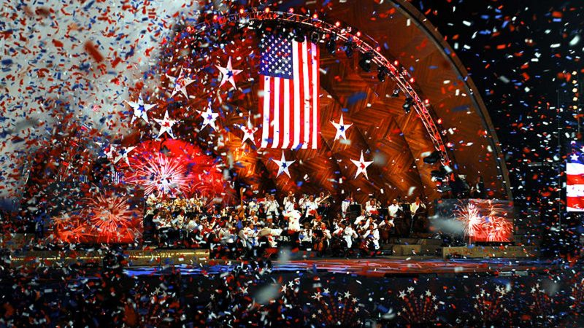
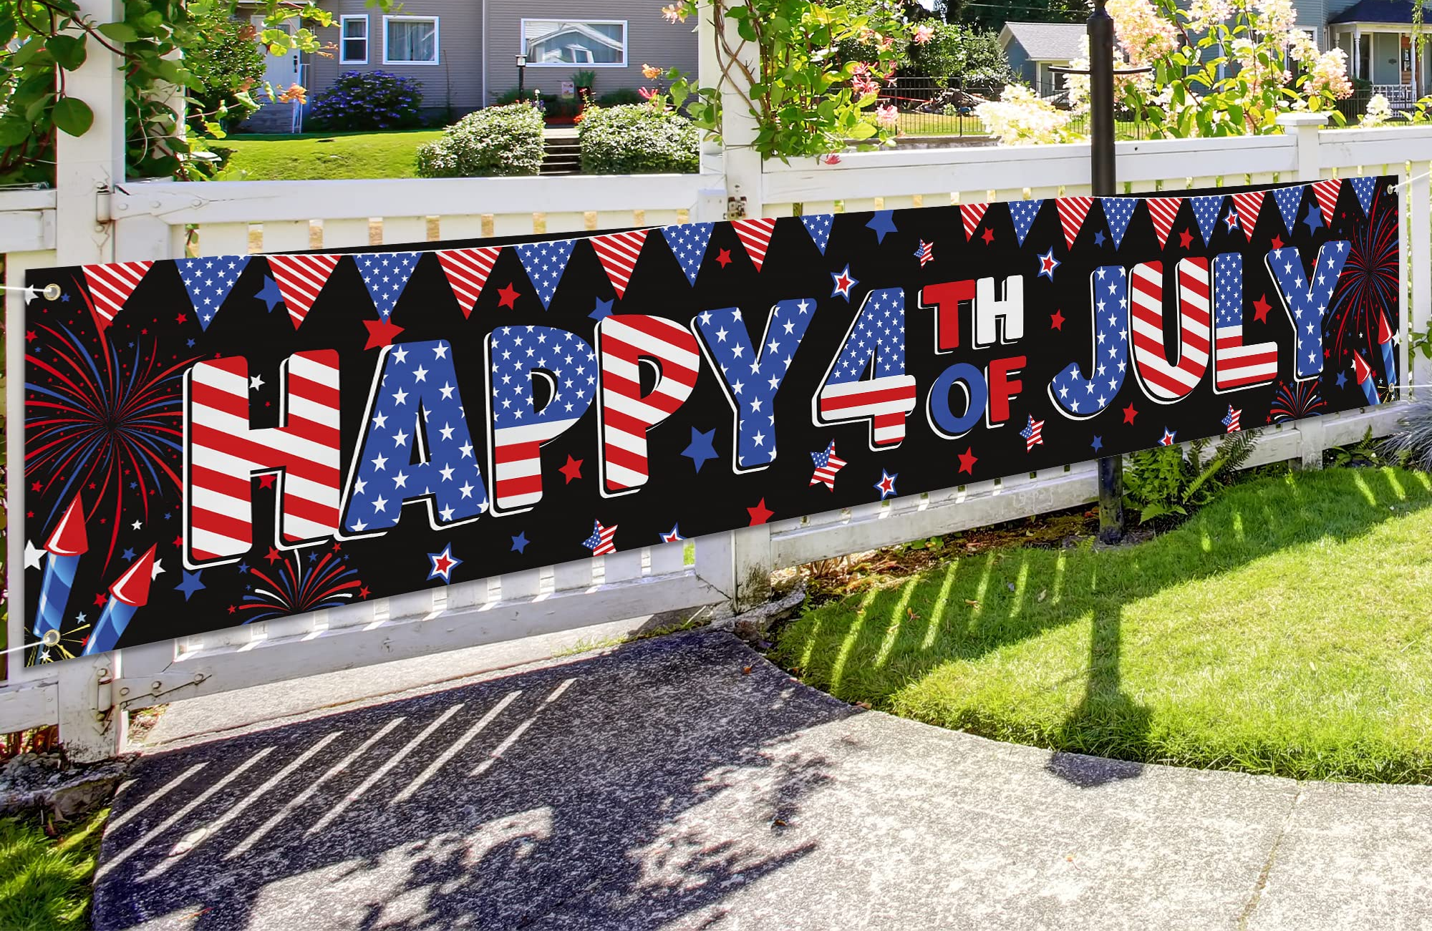
Who celebrates Independence Day?
-American people celebrate Indepence Day.
How do American people celebrate Independence Day?
They decorate the streets and houses with American flags.
They watch fireworks.
They go to the concerts.

Slide 6
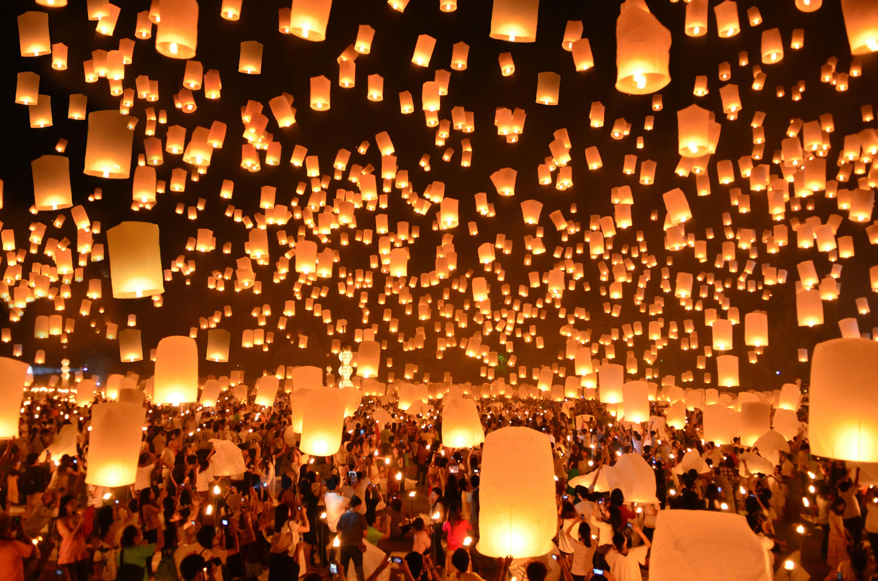
Which festival is this?
DIWALI FESTIVAL

Slide 7
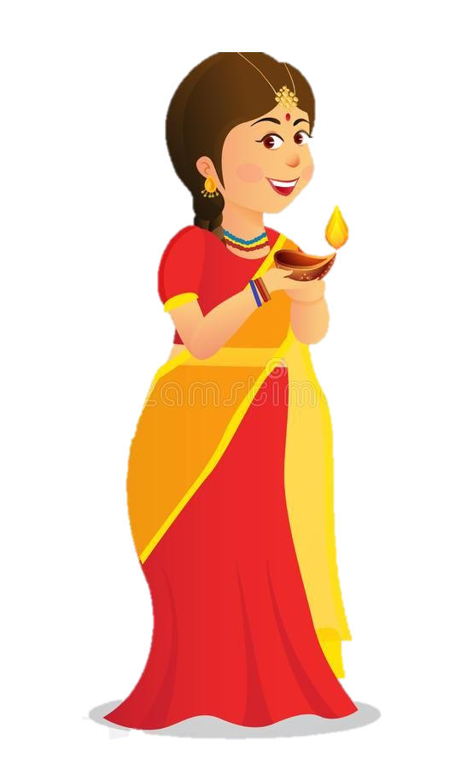
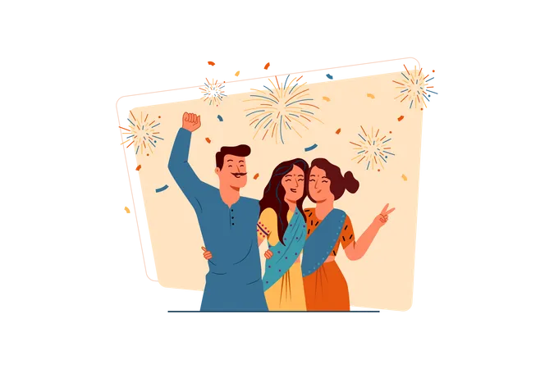
Diwali Festival
We celebrate the light winning over darkness and good over bad. We light lamps, decorate abd give gifts. It’s a happy time.

Slide 8
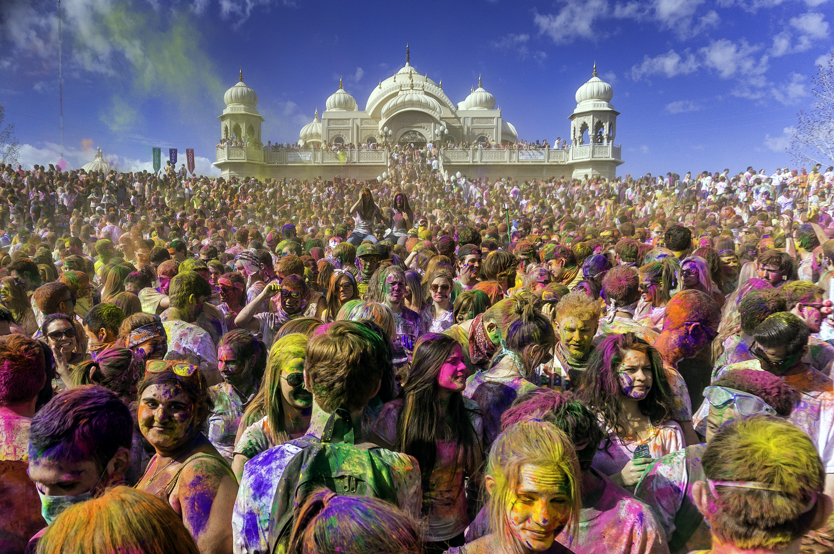
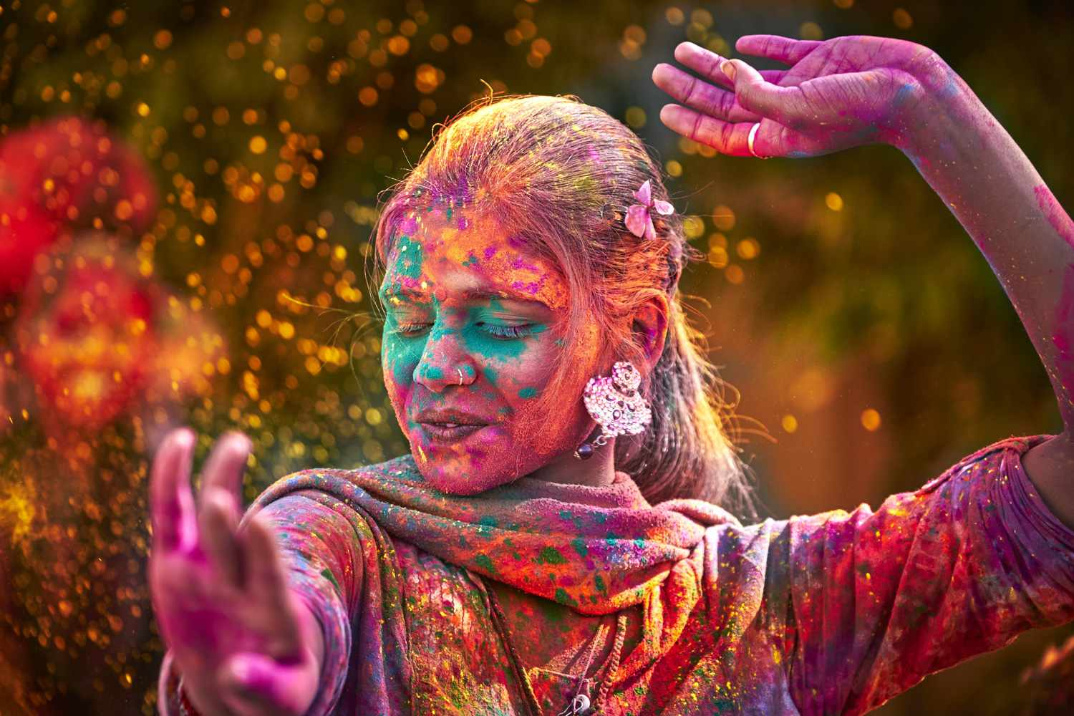
Which festival is this?
HOLI FESTIVAL

Slide 9
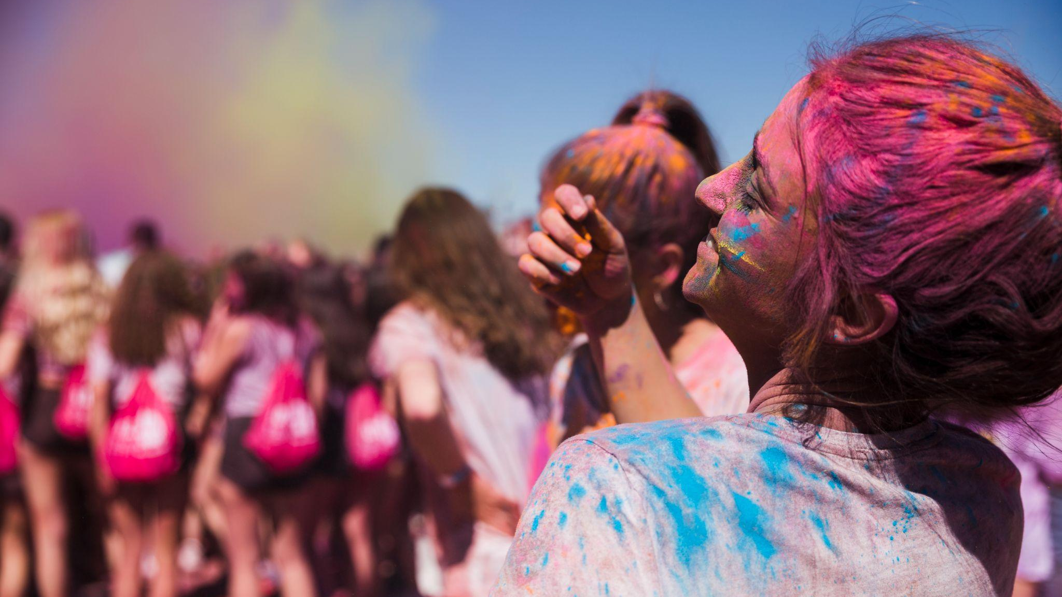
We celebrate spring, love and victory of good.

Slide 10
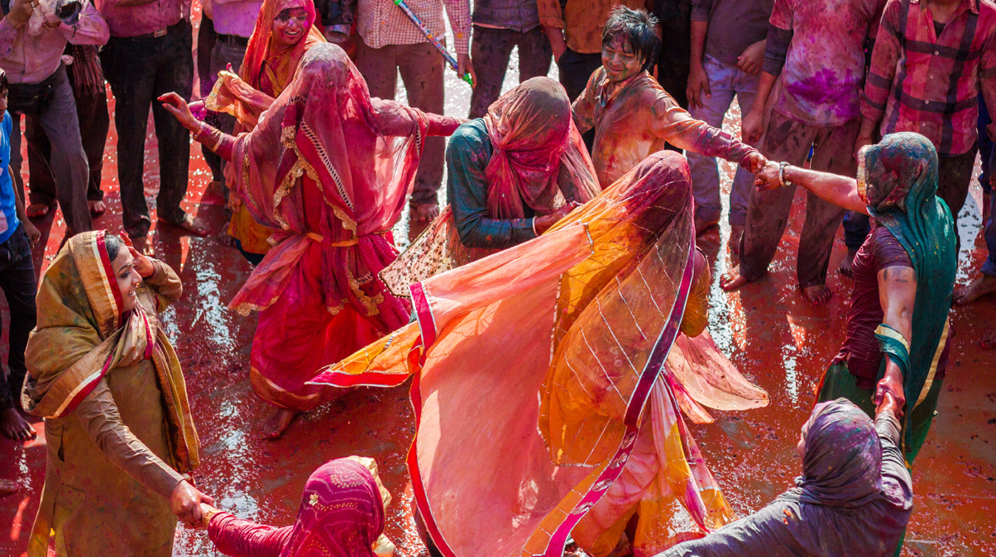
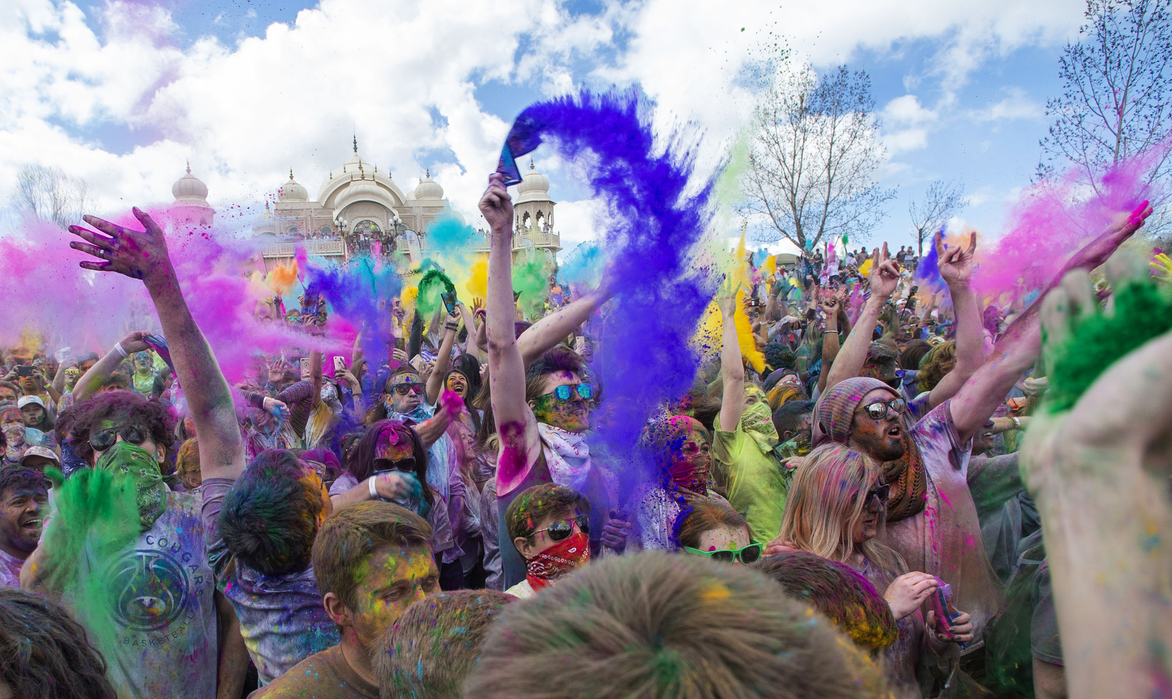
How do Hindu people celebrate the Holi Festival?
They dance and sing.
They throw colered powders.

Slide 11
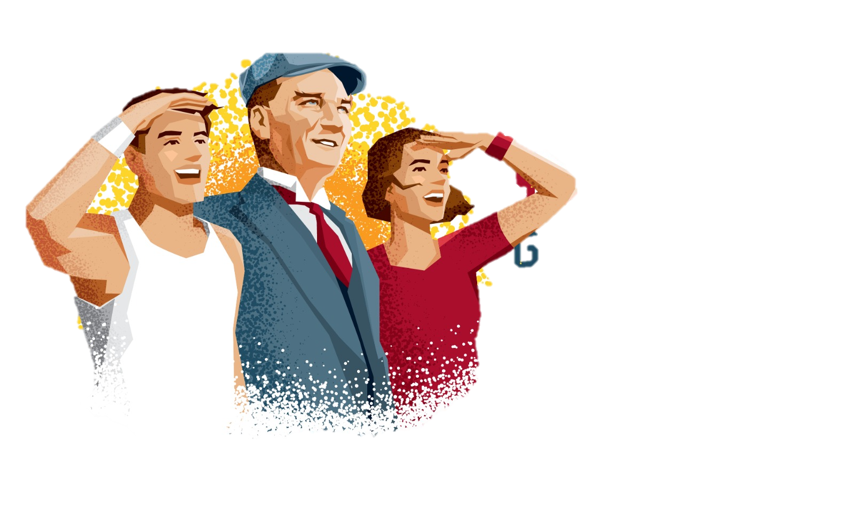
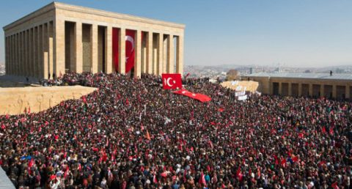
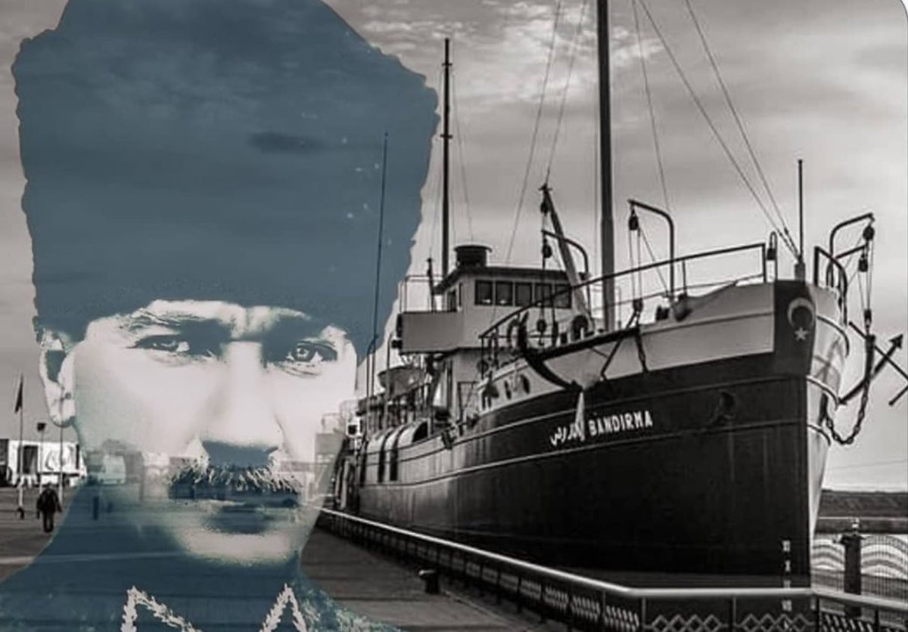
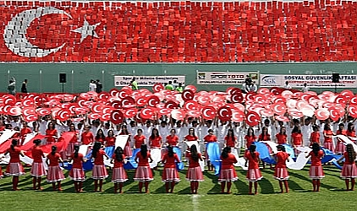
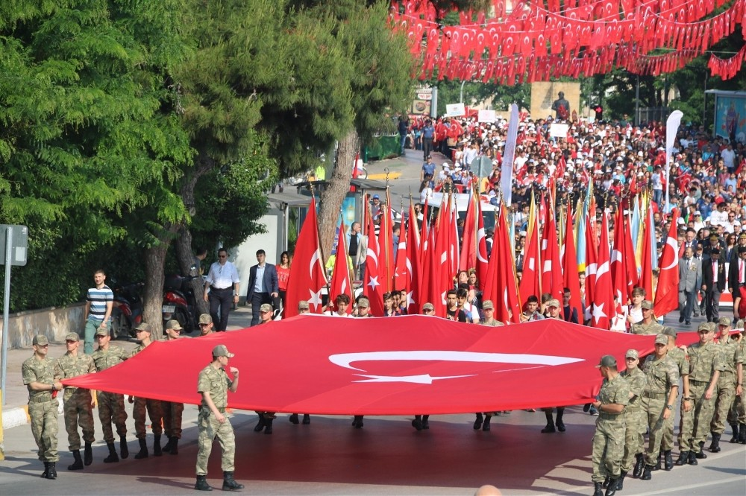
Which Festival is this?
Youth and Sports Day

Slide 12
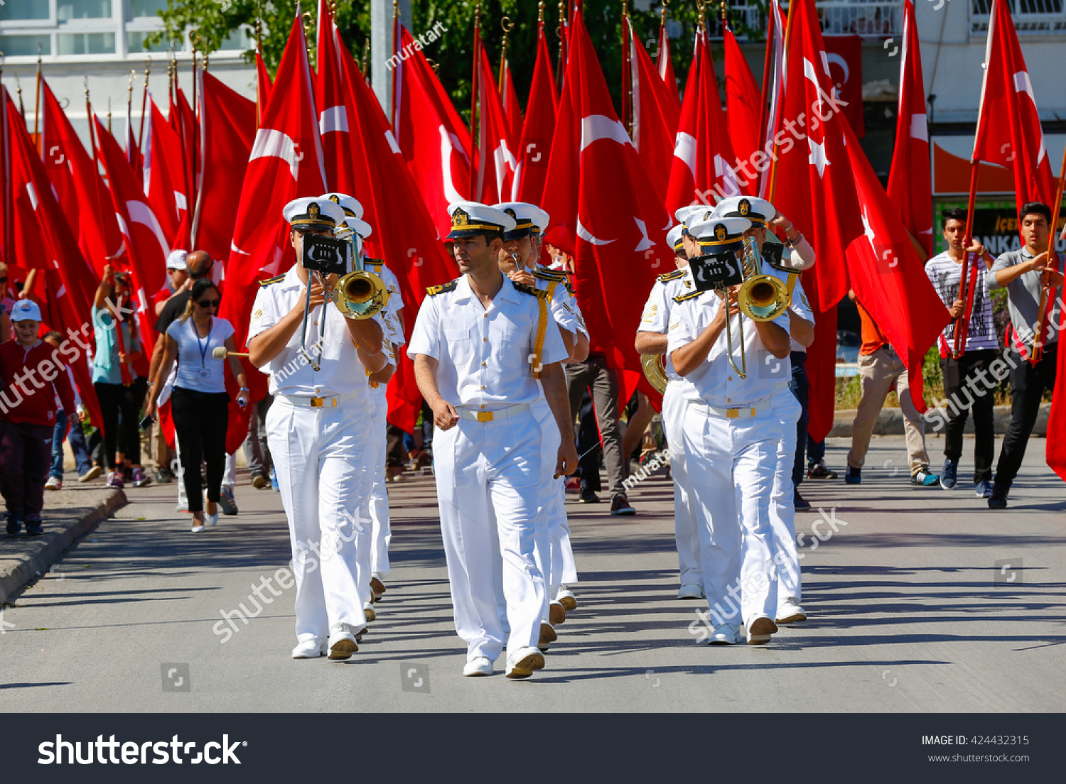
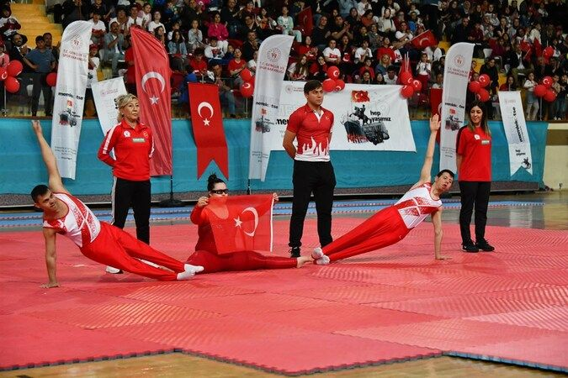
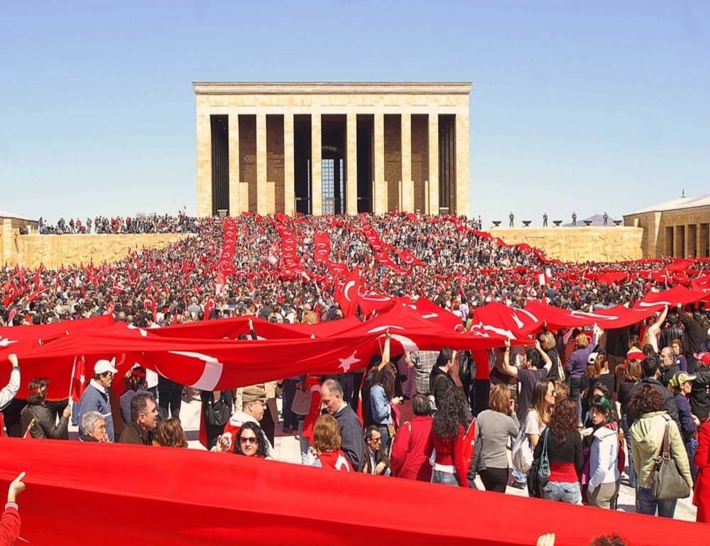
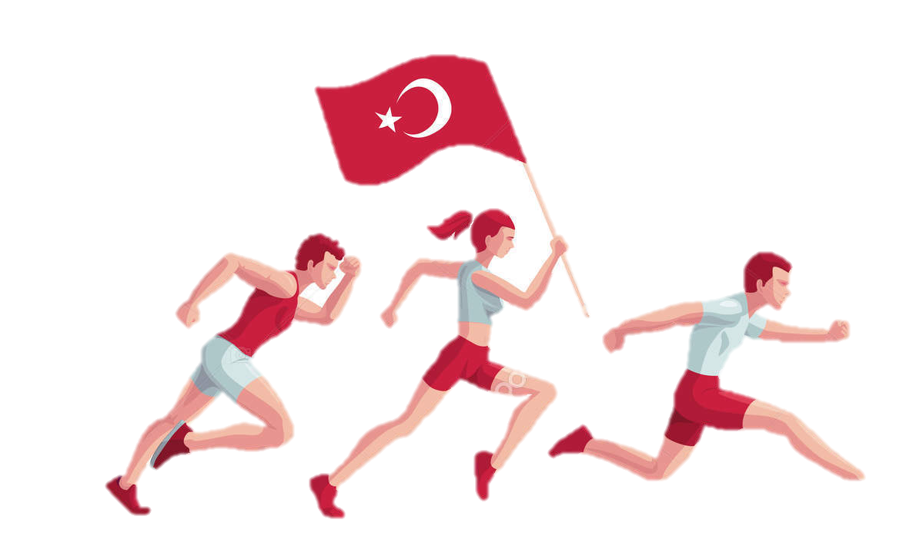
What do Turkish people celebrate in Commemoration of Atatürk Youth and Sports Day?
They celebrate the honor of Mustafa Kemal Atatürk and start of Turkish War of Independence.
This they celebrates youth as future!
How do Turkish people celebrate this day?
They goes to parades with Turkish flags.
They do sports activities.
They visit Anıtkabir.

