Slide 2

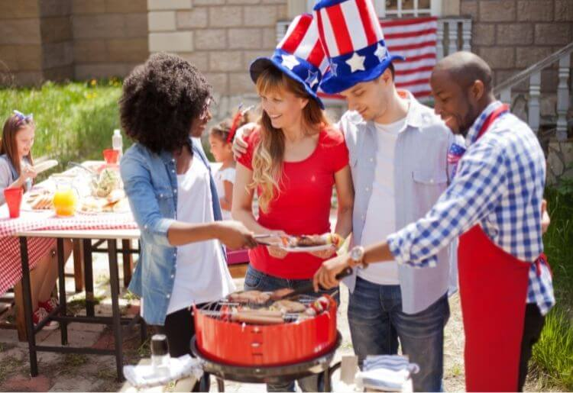
Which festivals do you know?
4th July, Independence Day in the United States of America:
On the 4th July, people have barbecue.

Slide 3
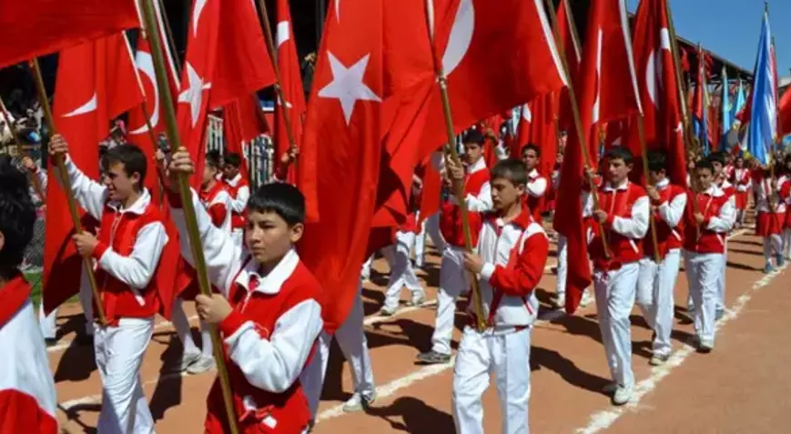
Which festivals do you know?
23th April, National Sovereignty and Children’s Day in Turkey:
On National Sovereignty and Children’s Day Child, we watch parades.

Slide 4
Some other festivals in Turkey!
Let’s see…

Slide 5
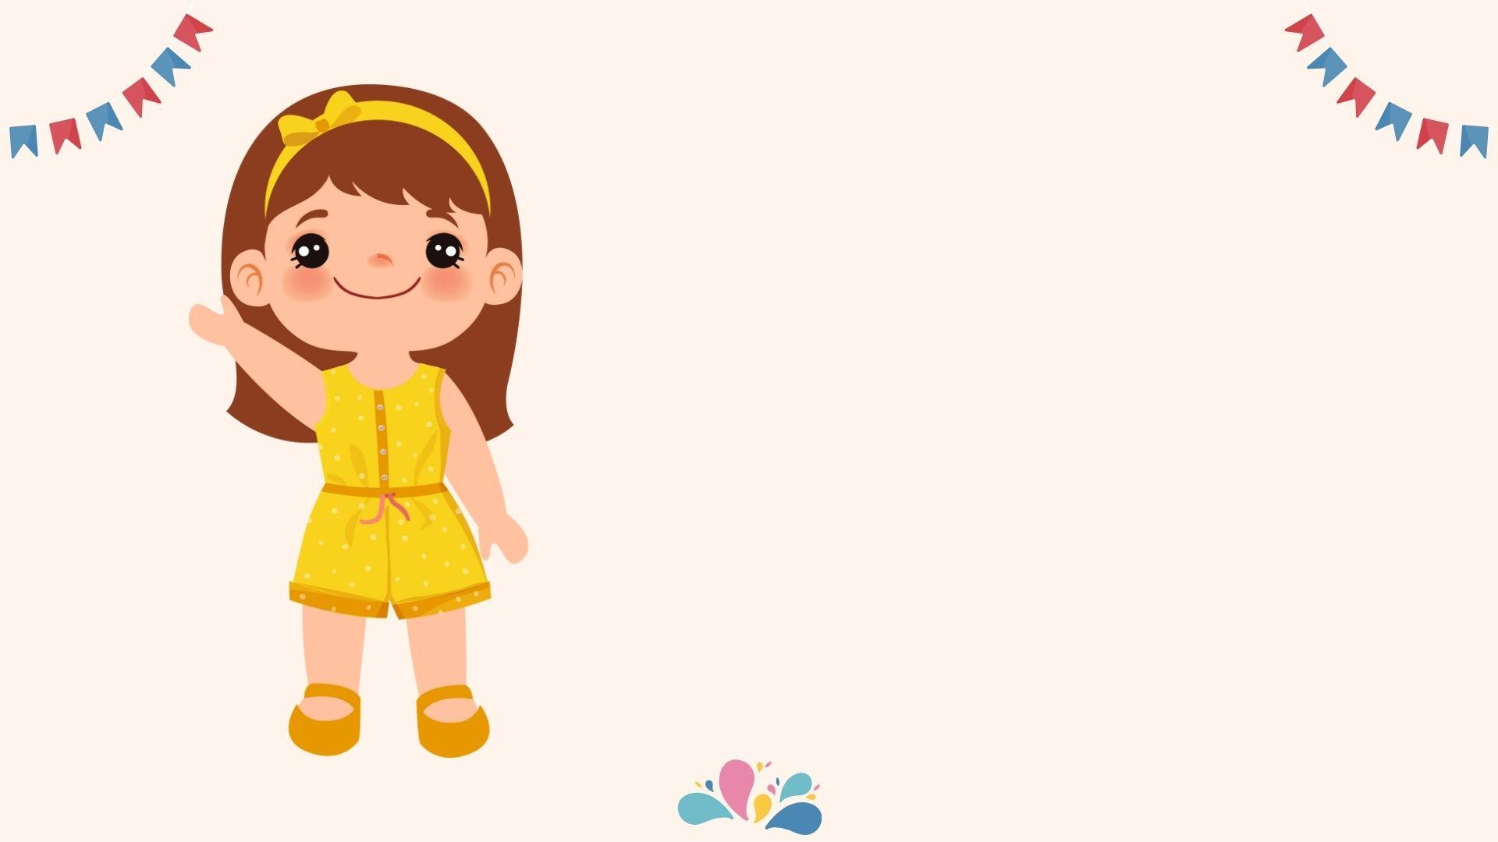
Hello! I am Şuşan.
I am a Suryani girl from Mardin.
My family and I celebrate Easter every April.

Slide 6

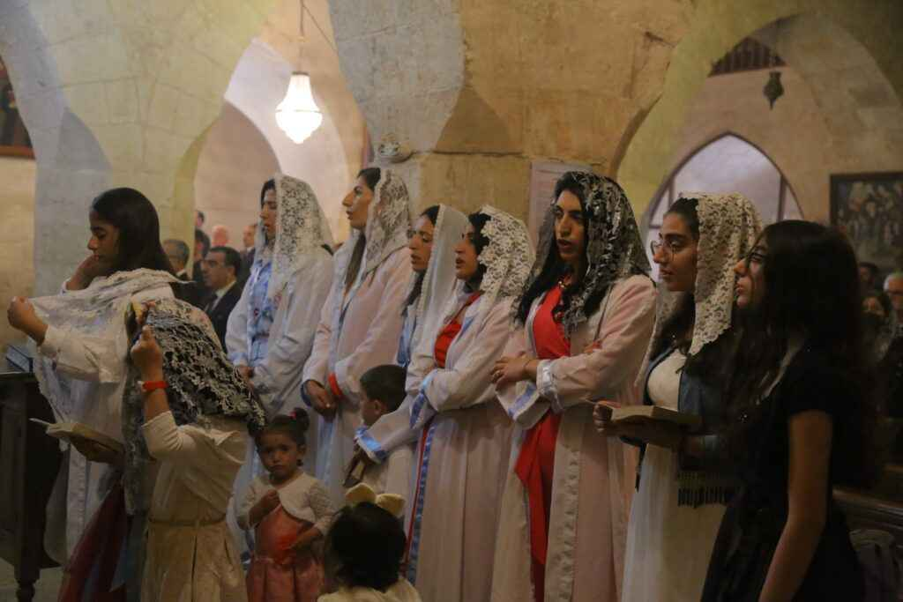
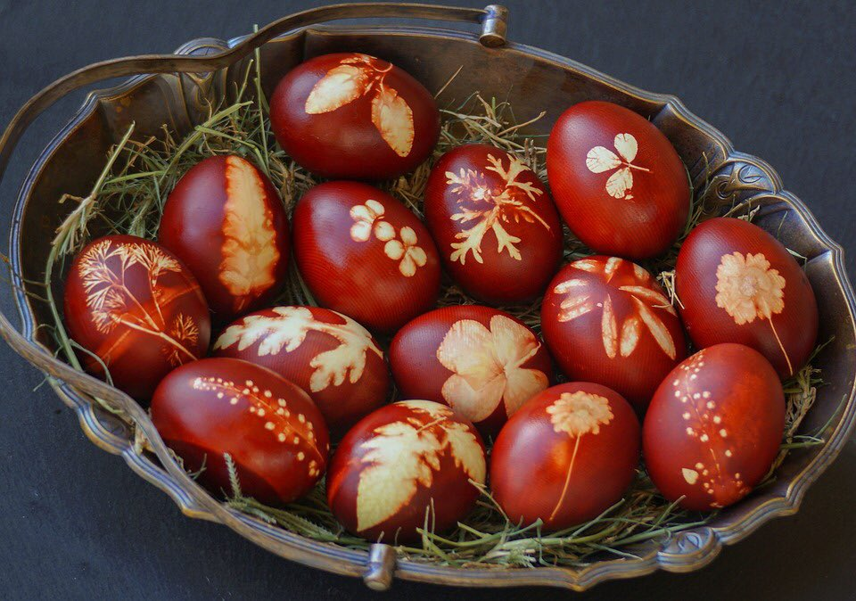
at Easter, we…
sing songs
and
paint eggs

Slide 7
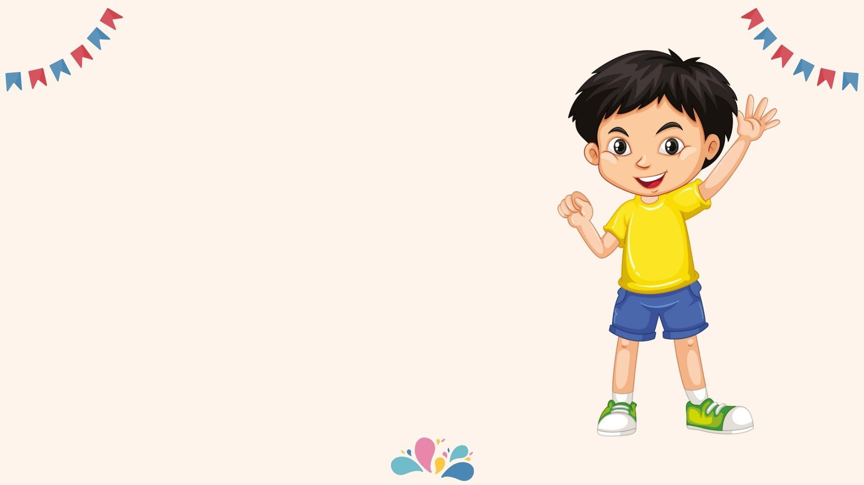
Hello, I am Dimitri
I am a Rum kid from İstanbul, Büyükada.
My family and I celebrate Aya Yorgi on 23rd April and 24th September.

Slide 8
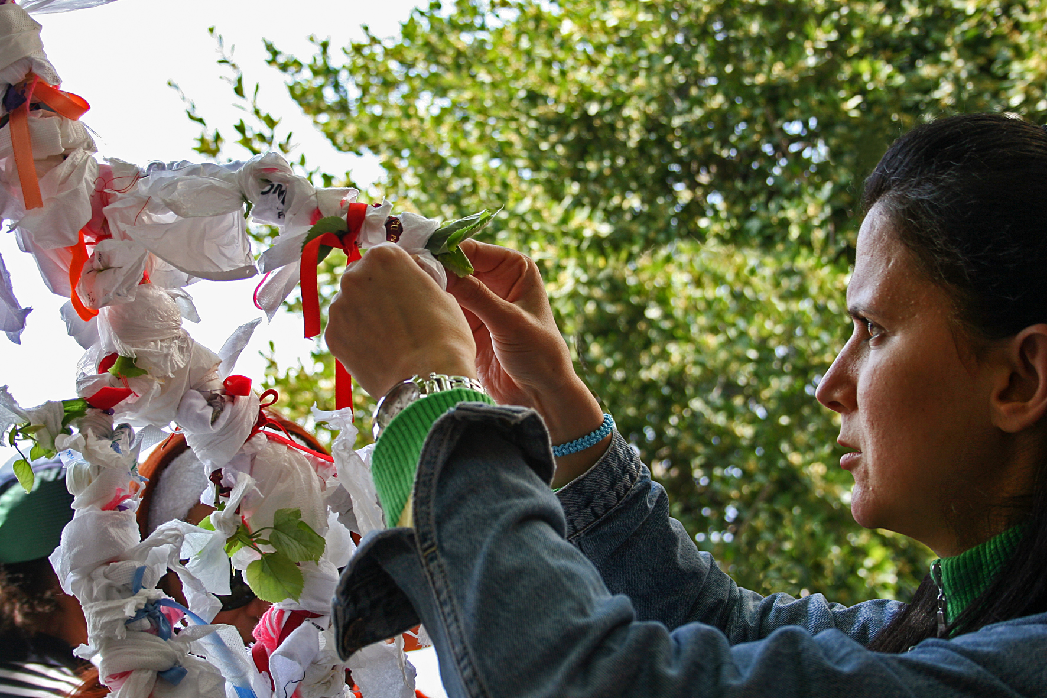
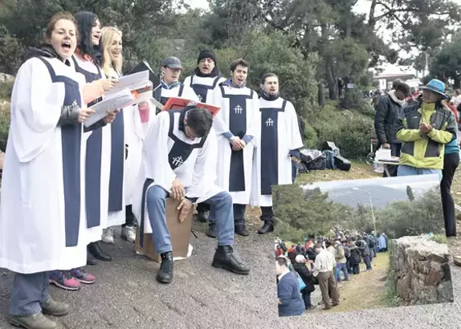
at Aya Yorgi, we…
make a wish
and
sing songs

Slide 9
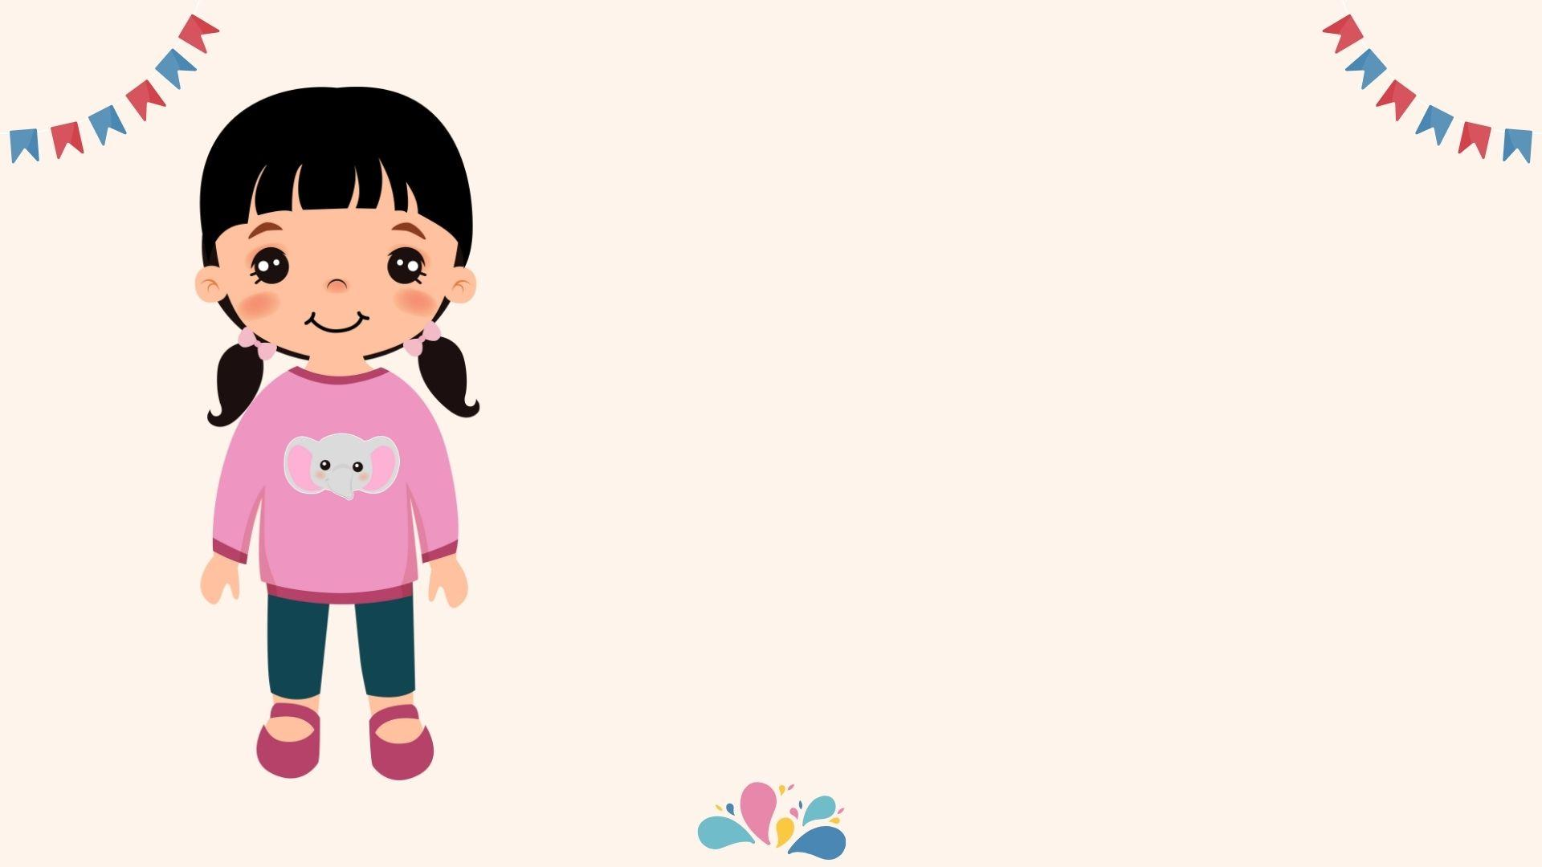
Hello, I am Maryam.
I am an Armenian girl from Hatay.
My family and I celebrate Vartavar every July.

Slide 10
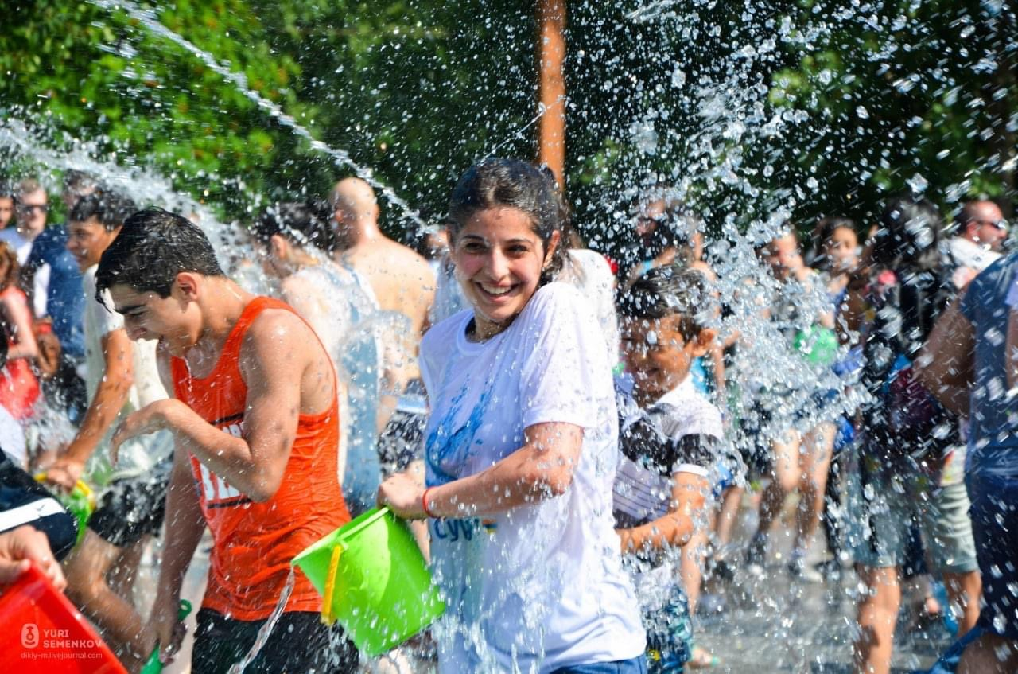
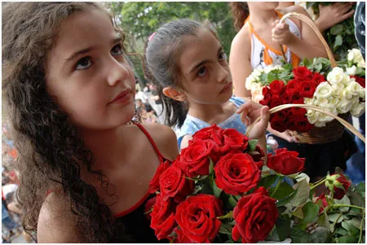
at Vartavar, we…
splash water
and
decorate the environment with roses

Slide 11
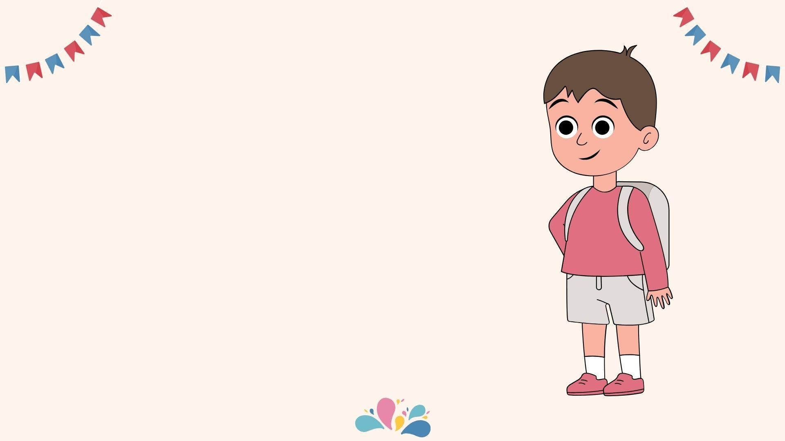
Hello, I am Baran.
I am a Kurdish kid from Diyarbakır.
My family and I celebrate Nowruz between 18th and 21st March.

Slide 12
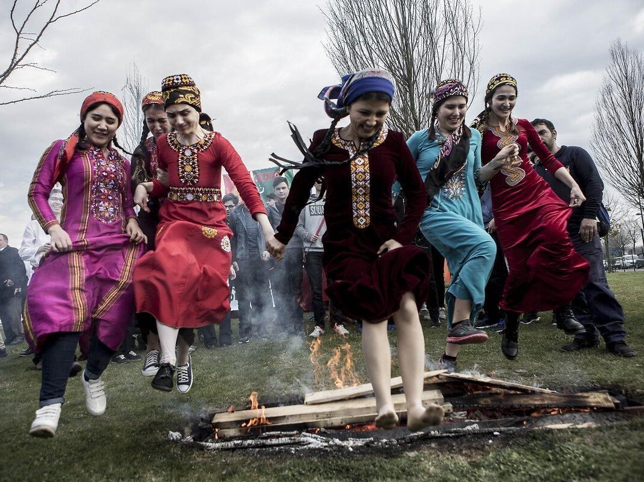
at Nowruz, we…
wear colorful
clothes and dance around the bonfire

Slide 13
How do we celebrate?
watch parades
have a barbecue
sing songs
paint eggs
make a wish
splash water
decorate
wear colorful clothes
dance (around the bonfire)

Slide 14
Let’s practice!

